Slide 1
Internet of THings
By Ankita George, Junjie Feng, Ruotian Zhang
Wangzhe Chen, Yue Yang, Vishal

Slide 2
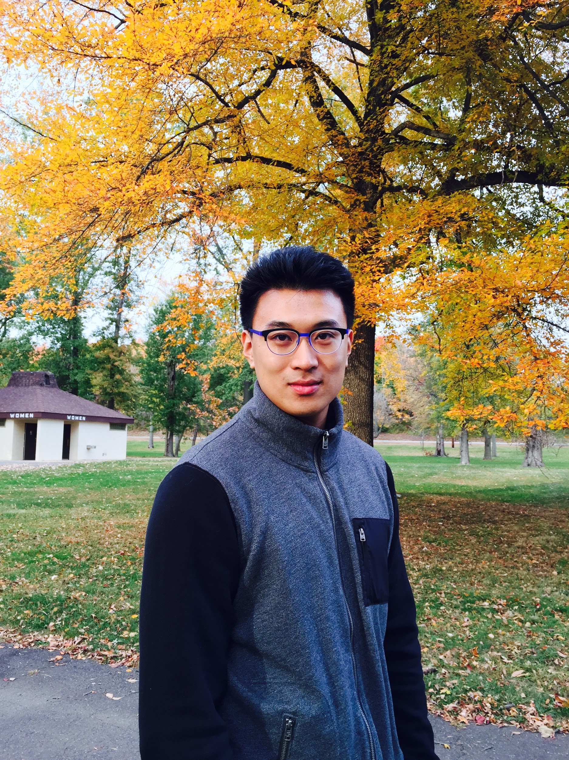
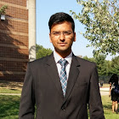
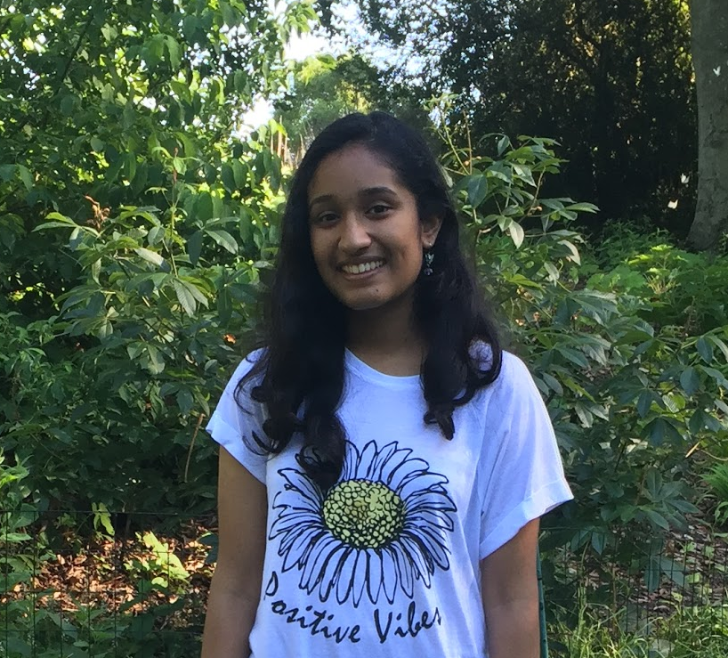
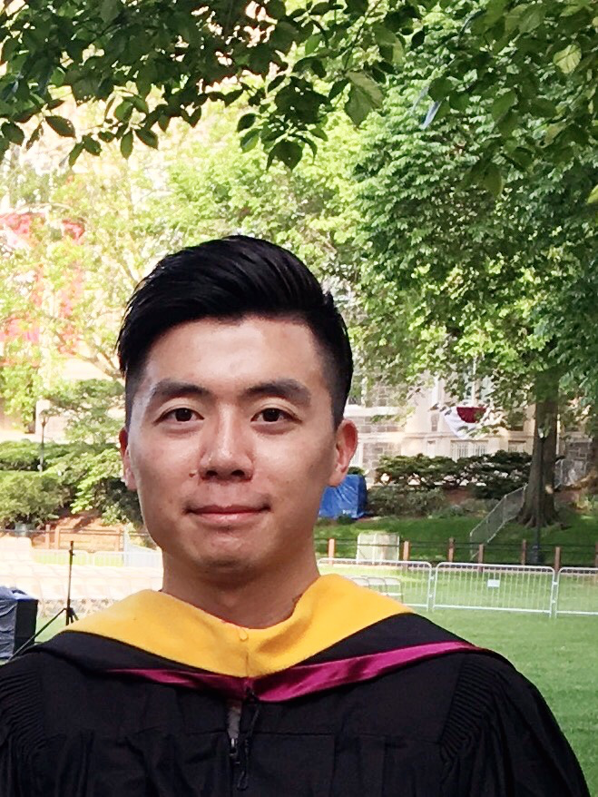
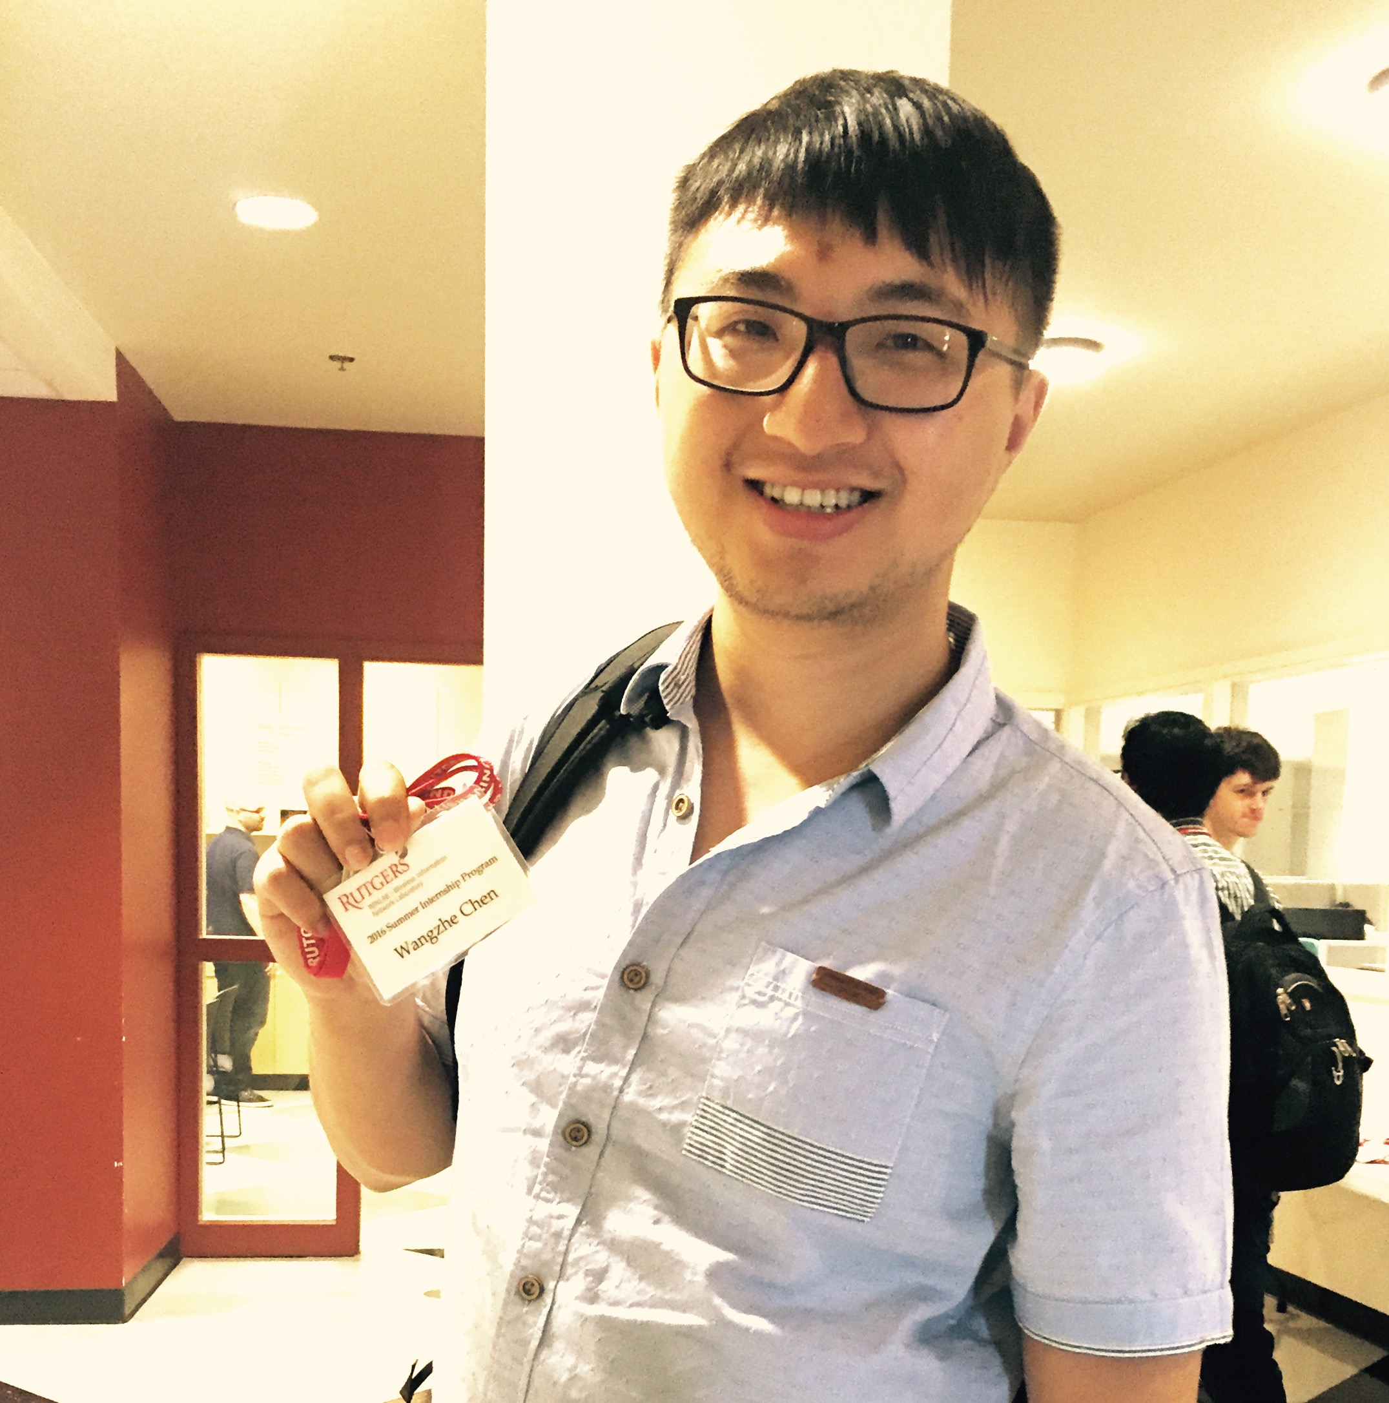
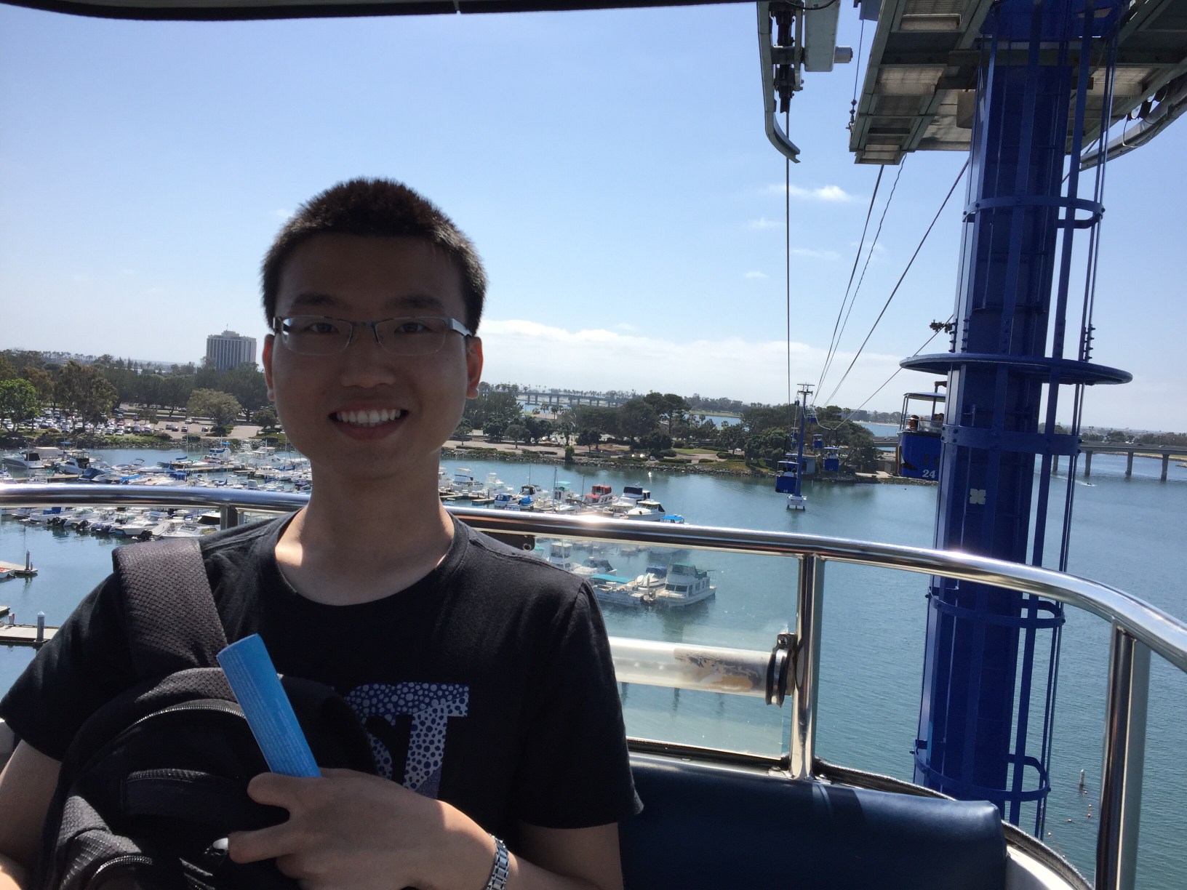
TEam Members
Ruotian Zhang
Vishal
Ankita George
Yue Yang
Wangzhe Chen
Junjie Feng

Slide 3
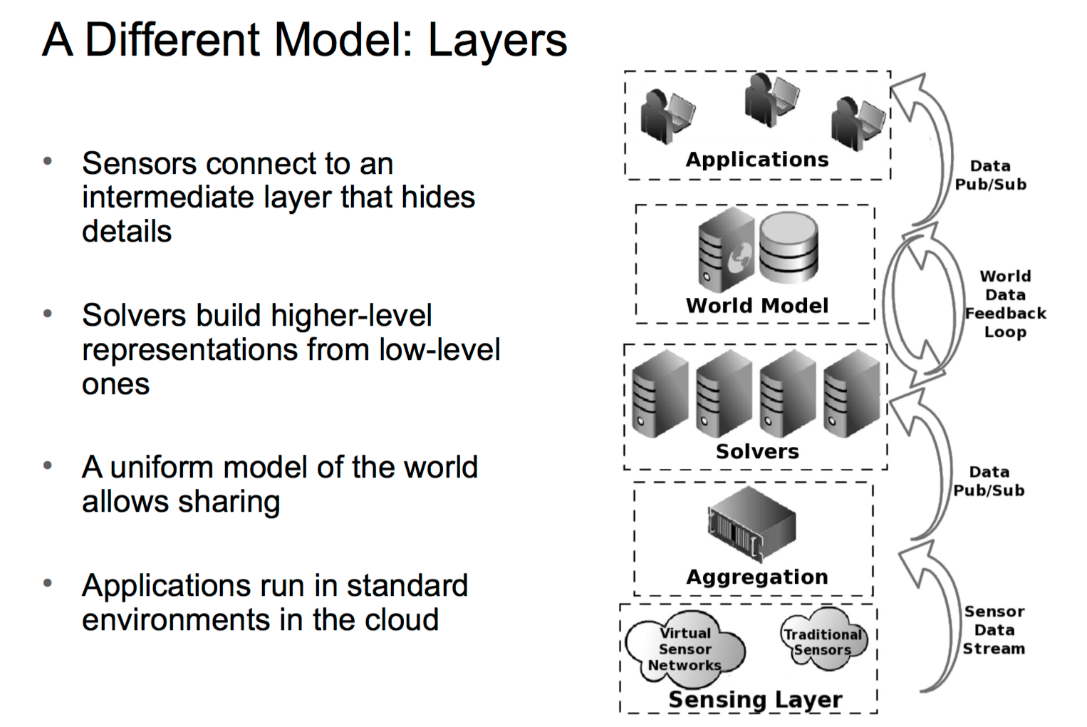
Worked on Aggregation layer, solvers layer and application layer
Populated real-time sensor data on the console.

Slide 4
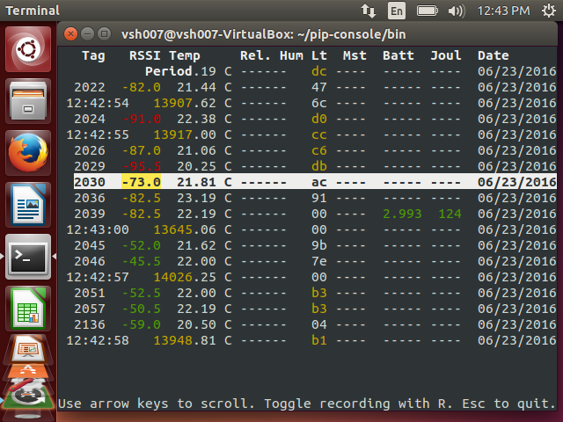
Data directly being collected by a receiver in real time.
One particular sensor can be used to sense multiple parameters.

Slide 5
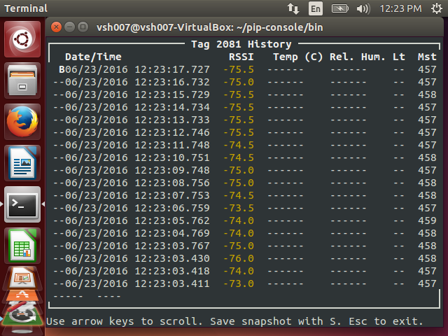
By clicking on any sensor tag, you can check the historical records of the sensed data.

Slide 6
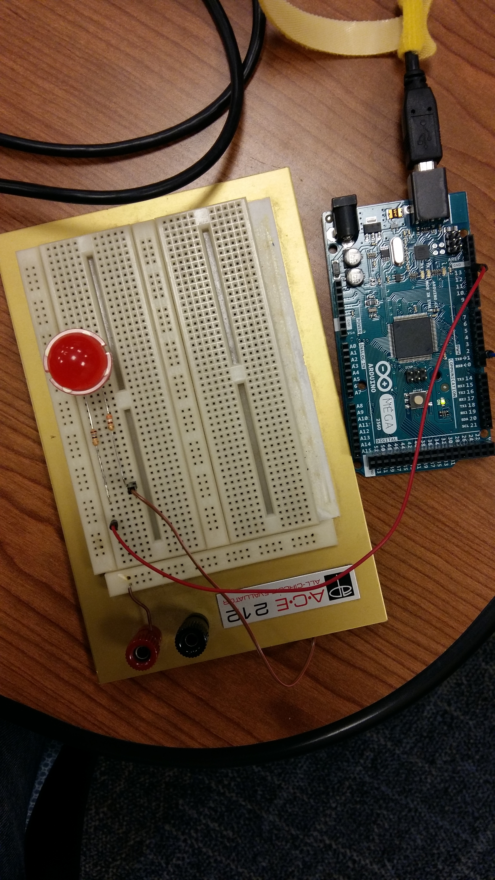
Actuator

Slide 7
Challenges
Integrating Google’s GeoLocation API with our planned Web application.
Sensitivity of some sensors is low.
Using different technologies like Node.js, Ajax and Jquery.
Chairs don’t send signals from all areas in winlab.

Slide 8
Plan for next week
Storing the sensor data in a database (mongoDB)
Backend of Owl Platform with the focus of incorporating data filtering.
Deploying Actuators along with the web application
Building our own sensors
Camera Based web application

